Slide 1
Case Study. Short Term solutions. To get reasonable usable service while waiting for the fibre broadband to arrive!

Slide 2
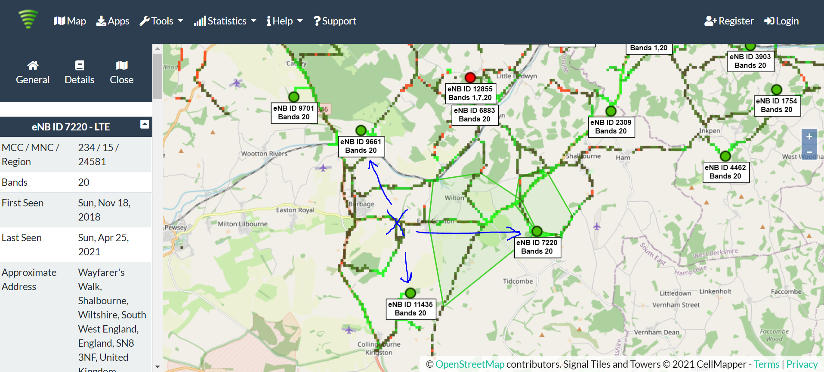
Example 4G coverage in my area
I live at the blue X. With my 4G antenna I can find three 4G masts. Currently I get the best performance from ID7220 at Wayfarers Walk Shalbourne.

Slide 3
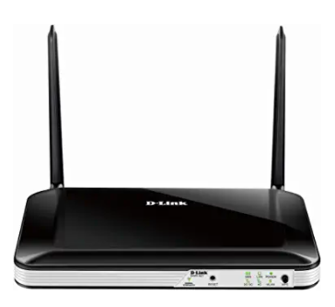
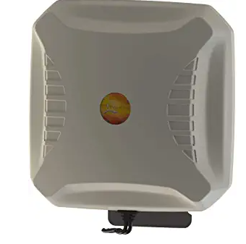
What is 4G Broadband?
Using a 4G Wireless Router
Small box similar to your existing Wifi hub
Has a slot for a mobile phone SIM card.
Cost from £100 on Amazon for the Hub
Plus a SIM only unlimited broadband SIM from your mobile phone provider. (around £30 a month)
Some Routers work better than others.
For example: Teltonika good, Dlink not so great
Option to Increase the performance using a external 4G Antenna
Additional ~£150 on top.
Suppliers like Poynting
Needs to be mounted as high as possible
Add the cost of Aerial installer on top

Slide 4
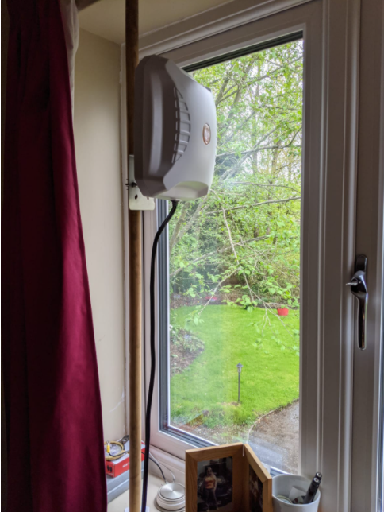
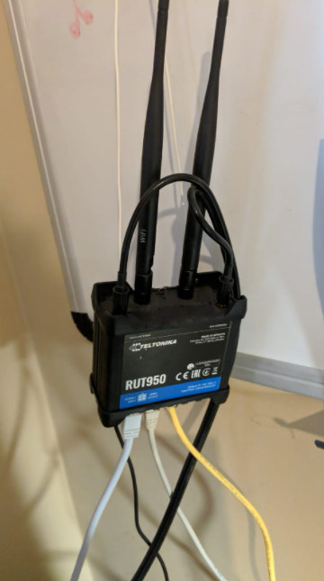
Experimental home setup
4G antenna in my upstairs office window. Very badly positioned, indoors pointing through triple glazing and a brick wall. Ideally this should be mounted outside as high as possible on the roof.
4G router, takes the signal from the antenna and converts it to Wifi and Ethernet for distribution inside the house.

Slide 5
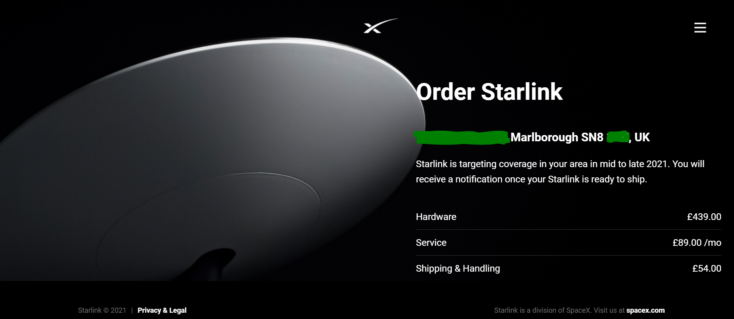
Starlink (SpaceX)
Backed by Elon Musk
1800 satellites launched (12000 planned)
340 miles above Earth
UK service started in January 2021

